Slide 1



Slide 2
DUE END OF Class: nov 22 (Friday)

Slide 3
Marking scheme:
30%: Planning Document: Reviewed with the Instructor individually
30%: Database structure fulfils all the requirements stated in this Document
40%: Database performed properly according to the 3 Specified SQL Statements

Slide 4
Developing the bicycle shop database

Slide 5

The requirement
You have been hired by a bicycle repair shop to create a Database to keep track of the details of customers who:
(1) Purchase a Bicycle [and are therefore entitled to free lifetime repairs], and
(2) customers who bring their Bicycle in to be repaired (for a $25/hour fee + cost of parts).
The Database Shall provide a data structure to store: customer information, bicycle information, and any other relator tables you need to put into your design to make the SQL relationships work

Slide 6
The requirement
Sketch the design for your Relational Database system with the necessary tables to make the above-stated requirement work.
State all fields in each table: Field Data types must be specified correctly.
Remember to identify your Primary keys.

Slide 7

Some important points
Remember that for Bicycle Repairs, you must state whether the Repair is WARRENTY or BILLABLE.
People who bought a bicycle from the shop have free lifetime repairs. Walk In Customers are charged $25/hour.
You will have to use LEFT, RIGHT, INNER and OUTER joins in the course of getting all your work done.

Slide 8

Deliverable requirements
An ORACLE Database with data-populated tables
You might find it easier to write the data in the form of spreadsheets and import it
Write 3 SQL Statements:
Generate a Report on all customers including bicycles they have purchased or brought in for repair
Generate a Report on all Bicycles purchased or brought in for repair.
Generate a Report on the activities of the Repair Department: How many bicycles they have repaired, time spent, and revenue generated

Slide 9
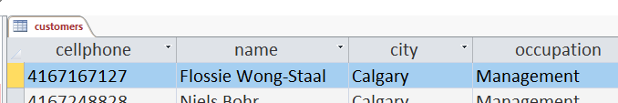
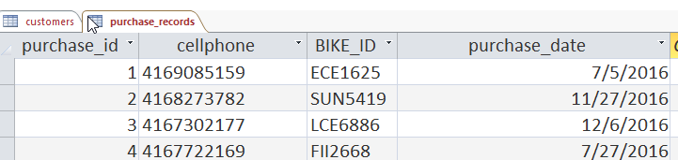
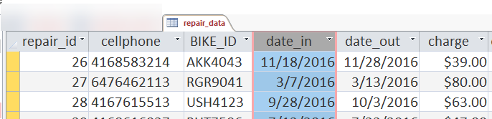
Deliverable requirements
Your database must have (at least) these tables and fields for my automated tests to work: [You may need more tables to meet the requirements of the Client]

Slide 10
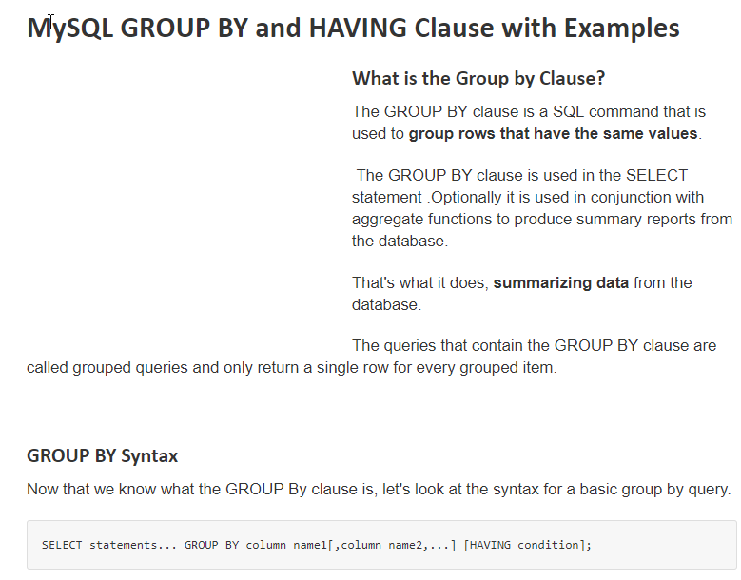
Notes:
https://www.guru99.com/group-by.html

Slide 11


Slide 12
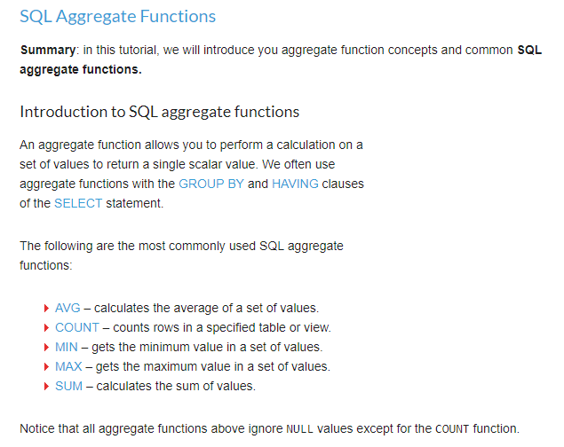
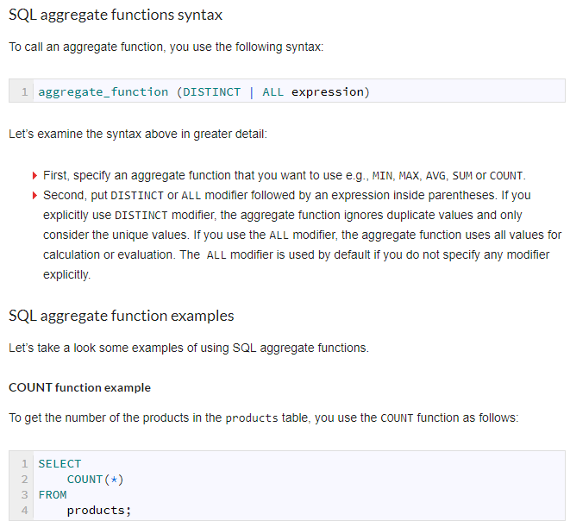
http://www.zentut.com/sql-tutorial/sql-aggregate-functions/

Slide 13
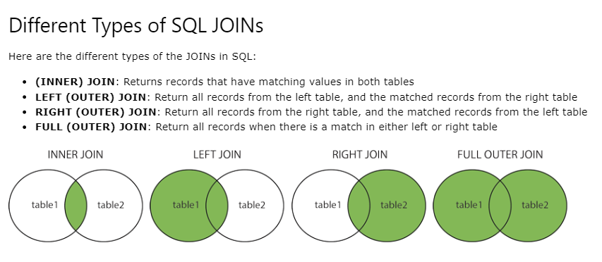

Slide 14
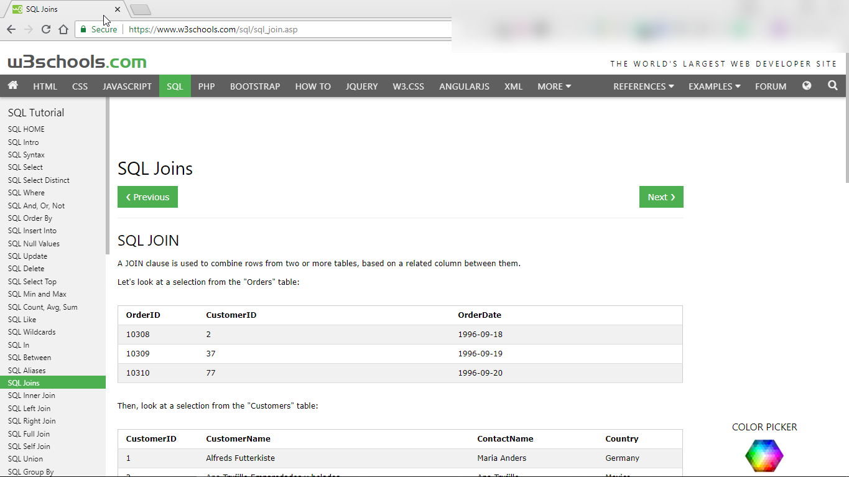

Slide 15
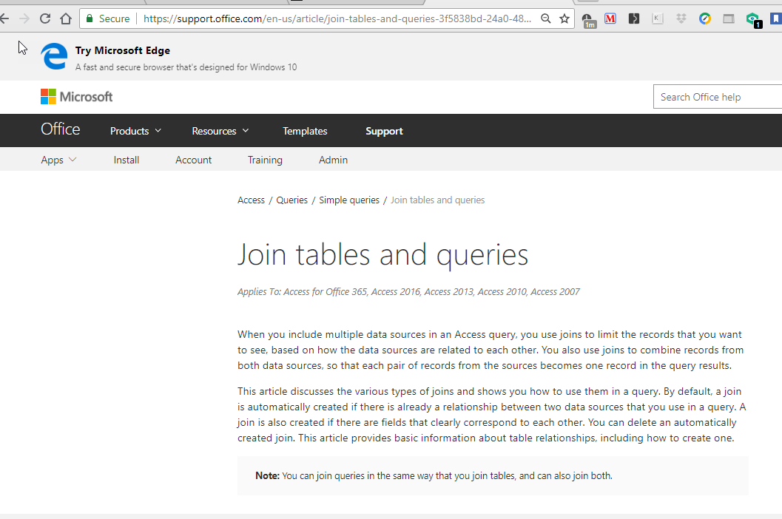
https://support.office.com/en-us/article/join-tables-and-queries-3f5838bd-24a0-4832-9bc1-07061a1478f6

Slide 16
Deliverable requirements
An ORACLE Database with data-populated tables
You might find it easier to write the data in the form of spreadsheets and import it
Write 3 SQL Statements:
Generate a Report on all customers including bicycles they have purchased or brought in for repair
Generate a Report on all Bicycles purchased or brought in for repair.
Generate a Report on the activities of the Repair Department: How many bicycles they have repaired, time spent, and revenue generated

Slide 17
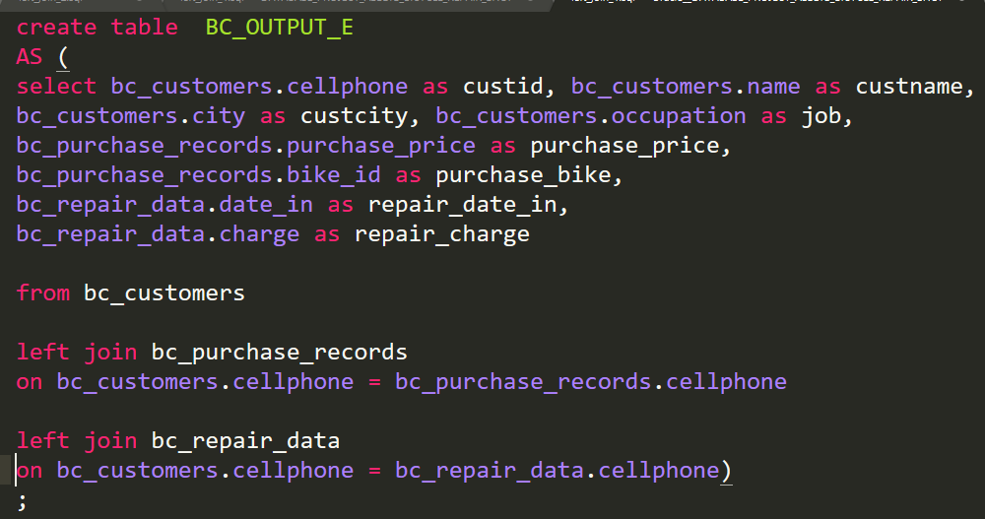
Generate a Report on all customers including bicycles they have purchased or brought in for repair
OUTPUT THE RESULTS TO A NEW TABLE:

Slide 18
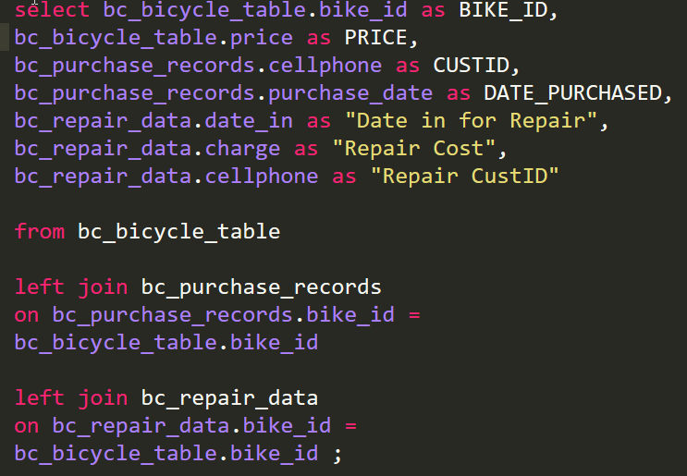
Get ALL BICYCLES. This can include: Bikes in stock (Not Sold), Bikes SOLD, Bikes REPAIRS (either bough from us or by customers who purchased else where)
Generate a Report on all Bicycles purchased or brought in for repair
LEFT JOINS:

Slide 19
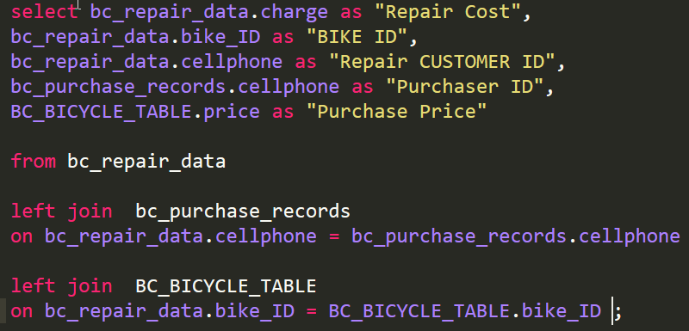
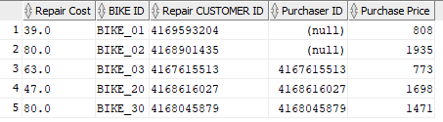
Generate a Report on the activities of the Repair Department: How many bicycles they have repaired, time spent, and revenue generated
BUT: How to return a price of
ZERO for repairs done by Purchasers from our shop??

Slide 20
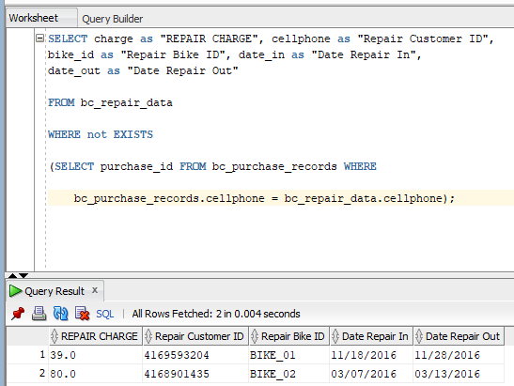
Generate a Report on the activities of the Repair Department: How many bicycles they have repaired, time spent, and revenue generated
This CORRRELATED SUBQUERY
Reports only on repair charges for non-purchaser customers.

Slide 21
Correlated subquery in oracle
select repair_id, CUSTOMER_ID, bike_id, date_in, date_out,
charge
from BC_REPAIRS
where NOT EXISTS
(select purchase_id from BC_PURCHASES
where BC_PURCHASES.CUSTOMER_ID = BC_REPAIRS.CUSTOMER_ID
);
Notes:
http://www.dba-oracle.com/t_correlated_subquery.htm
http://www.oracletutorial.com/oracle-basics/oracle-correlated-subquery/

